Slide 1
Recursion
COS 1020 C++ Programming
AUBG COS Department
Based on chapter 12 – problem solving, abstraction and design using C++, Friedman & Koffman

Slide 2
Lecture Contents
12.1 The Nature of Recursion
12.2 Tracing Recursive Functions
12.3 Recursive Mathematical Functions
12.4 Recursive Functions with Array Arguments

Slide 3
Nature of Recursion
A powerful problem solving tool
Recursive function: a function that calls itself
Problems that can be solved by recursion have:
  One or more simple case of the problem have a straightforward, non-recursive solution (stopping case)
  Other cases can be reduced to one or more problems that are closer to a stopping case
  Eventually the problem can be reduced to stopping cases only, which are easy to solve

Slide 4
Solving a Recursive Problem
The steps for defining a recursive problem are:
  1. Try to express the problem as a simpler version of itself
  2. Determine the stopping cases
  3. Determine the recursive steps

Slide 5
A Recursive Algorithm
An algorithm for a recursive function usually has this form:
If stopping case reached
Solve the problem
Else
Split the problem into simpler cases
and solve them recursively

Slide 6
Splitting a Problem into Smaller Problems
Size n
Problem
Size n-1
Problem
Size n-2
Problem
. . .
Size 2
Problem
Size 1
problem
Size 1
problem
Size 1
problem
Size 1
problem
Size 1
problem

Slide 7
Power by Multiplication
Problem: “Raise 6 to the power of 3”
Raise 6 to the power of 3
  Raise 6 to the power of 2
  Multiply the result by 6
Raise 6 to the power of 2
  Raise 6 to the power of 1
  Multiply the result by 6
End up multiplying 6 * 6 * 6

Slide 8
Example: Recursive Function power
int power(int m, int n)
{
if (n <= 1)
return m; // stopping case
else
return m * power(m, n - 1); // recursion
}

Slide 9
Tracing Recursive Functions
Hand tracing the execution of an algorithm provides valuable information how it works
Also very useful in recursion
Activation frame corresponds to a function call with argument values shown

Slide 10
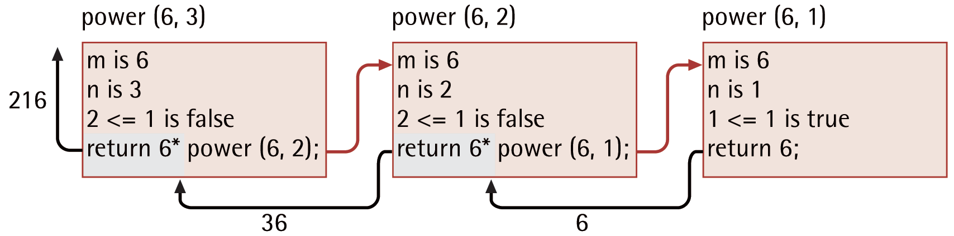
Tracing the Function power

Slide 11
Example: Function power with tracing
int power(int m, int n)
{
int answer;
cout << "Entering power with m = " << m << " and n = " << n << endl;
if (n <= 1)
answer = m; // stopping case
else
answer = m * power(m, n - 1); // recursion
cout << "power(" << m << ", " << n << ") returns " << answer << endl;
return answer;
}

Slide 12
Recursive Function with No Return Value
The next example shows an unusual recursive function with no parameters and no return value
Contains an if statement with some stopping condition
  Keeps executing the recursive step until condition is reached
When the stopping case is reached:
  The recursive step is finished
  Execution returns to the previous call

Slide 13
Example: Function reverse
// Displays keyboard input in reverse
void reverse()
{
char next;
cout << "Next character or * to stop: ";
cin >> next;
if (next != '*') {
reverse(); // recursive step
cout << next; // display next after return
}
}

Slide 14
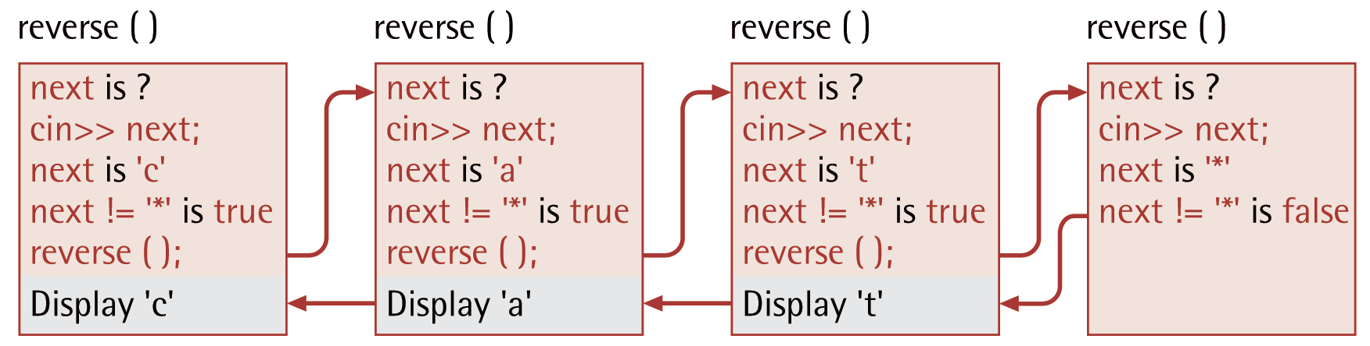
Trace of Function reverse

Slide 15
Recursive Mathematical Functions
Many mathematical functions are defined recursively
Example: The factorial of a number – n!
    0! is 1
    n! is n × (n-1)!, for n > 0
    Therefore: 4! = 4 × 3! = 4 × 3 × 2! = 4 × 3 × 2 × 1 or 24

Slide 16
Example: Recursive factorial Function
// compute and return n!
int factorial(int n)
{
if (n <= 0) // base case
return 1;
else
return n * factorial(n - 1);
}

Slide 17
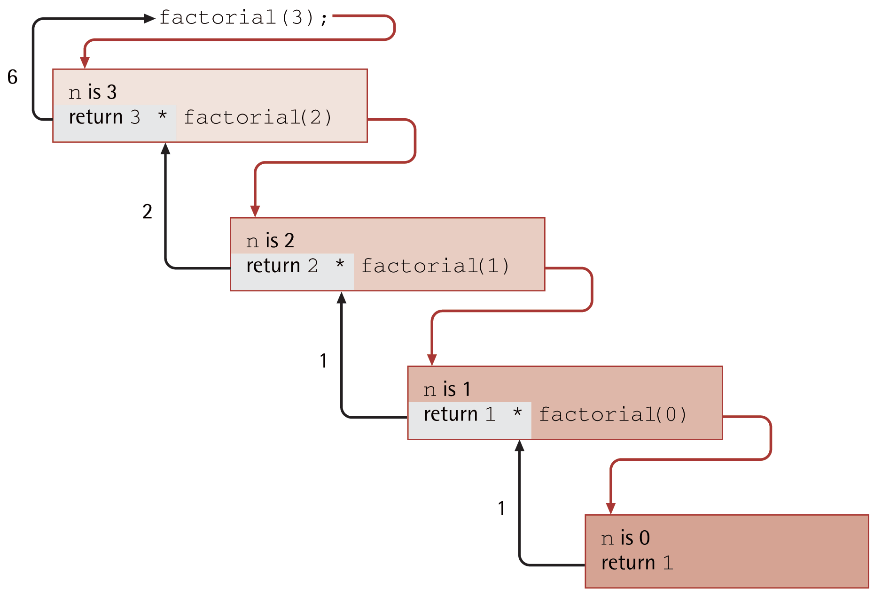
Trace of factorial(3)

Slide 18
Example: Iterative Factorial Function
int factorialIter(int n)
{
// Local data
int factorial; // accumulating product
factorial = 1;
for (int i = 2; i <= n; i++)
factorial *= i;
return factorial;
}

Slide 19
Recursive fibonacci Function
// Returns the nth Fibonacci number
int fibonacci(int n)
{
if (n <= 2) // base case
return 1;
else
return fibonacci(n - 2) + fibonacci(n - 1);
}

Slide 20
Recursive Functions with Array Arguments
Recursive functions can also process data structures or objects – e.g. arrays
A recursive solution to an array processing problem involves splitting it into two or more problems with smaller size arrays
For example, a problem involving an n-element array can be split into a problem involving an n-1 element array and a single element
Normally an array with one element is a stopping case

Slide 21
Example: Finding the Sum of All Elements in an Array
// Finds the sum of elements in an n-element array
int findSum(int x[], int n)
{
if (n == 1) // stopping case
return x[0];
else
return x[n - 1] + findSum(x, n - 1); // recursive step
}

Slide 22
Example: Finding the Sum of All Elements in an Array
2 | 3 | 5 | 7
sum = 7, size = 4
sum = 7 + 5, size = 3
sum = 12 + 3, size = 2
sum = 15 + 2, size = 1
2 | 3 | 5 | 7
2 | 3 | 5 | 7
2 | 3 | 5 | 7

Slide 23
Case Study: Binary Search
One algorithm for finding a target element in an array is sequential search – examining each element in the sequence
If the input array has been sorted, we can use an alternative, more efficient search method – binary search
In binary search we reduce the problem of searching an n-element array to a search involving an n/2 element array
Problem: Write a function to implement binary search

Slide 24
Example - Searching For 8
2 | 3 | 5 | 7 | 8
 |  |  | 7 | 8
 |  |  |  | 8

Slide 25
Case Study: Analysis
The binary search algorithm uses the ordering of array elements to eliminate half of them with each probe
We compare the middle element of the array with the target value
  If they are equal, we are done
  If the middle element is larger than the target, we search in the lower subarray
  Otherwise, we search the upper half

Slide 26
Case Study: Analysis (continued)
Function interface
  Input parameters:
    table – array to search in
    target – target value
    first – index of first element of the subarray
    last – index of the last element in subarray
  Result:
    If found, location of target in the array
    If not found, -1

Slide 27
Case Study: Design
We can implement the binary search algorithm by using recursion
There will be two stopping cases:
  The array bounds are improper (first > last)
    Returns -1 to indicate target not found
  The middle value is the target value
    Returns the index of the found target value
The recursive step is to search the appropriate subarray

Slide 28
Binary Search Algorithm
1. Compute the subscript of the middle element of the array
2. If the array bounds are improper:
Target not present, return -1
3. Else if target is the middle value:
Return subscript of middle value
4. Else if target is less than the middle value:
Search subarray with indices first through middle-1
5. Else:
Search subarray with indices middle+1 through last

Slide 29
Example: Recursive Binary Search Function
int binSearch(int table[], int target, int first, int last)
{
int middle = (first + last) / 2;
if (first > last)
return -1;
else if (target == table[middle])
return middle;
else if (target < table[middle])
return binSearch(table, target, first, middle - 1);
else
return binSearch(table, target, middle + 1, last);
}

Slide 30
Questions?
Q & A

